Slide 1
Reliability of Systems
Overview
Series System
Parallel System (Redundant System)
Combined Series-Parallel Systems
  High-level versus Low-level Redundancy
  k-out-of-n Redundancy
Reliability Consideration in Design

Slide 2
Motivation
Before …
Several probability models useful in describing different failure processes:
Constant Failure Rate Model
  Exponential Distribution
Time-dependent Failure Models
  Weibull Distribution
  Normal Distribution
  Lognormal Distribution
Next …
System Structure or Configuration
We are interested in the System Reliability
System reliability depends on both
  Reliability of the components
  System structure or configuration

Slide 3
Goal
To study how system reliability depends on component reliability and system structure:
Estimate system reliability
Examine how to improve system reliability
  Improve component reliability?
  Change system structure?
  Build in redundancy?

Slide 4
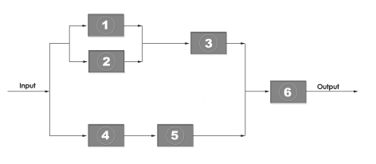
Introduction
System – a collection of components or subsystems assembled to perform a specific task.
Typical System Structures:
  Series System
  Parallel System (Redundant System)
  Combined Series-Parallel Systems
Representations of System Structure
  Reliability Block Diagram
  – a logic diagram representing the arrangement of components

Slide 5
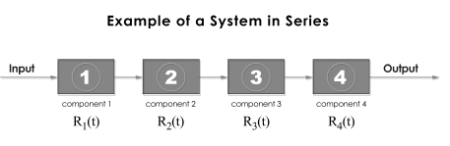
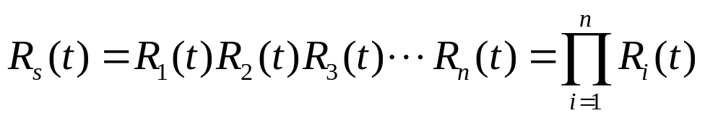
Series System
In a series system, all components or subsystems must function for the system to function. (A series system fails as long as any one of the components fails.)
Reliability Block Diagram
Applications:
Some computer networks
Chains, Multi-cell batteries
Decorative tree-lights
Basic Equation for System Reliability:
When components fail independently,

Slide 6
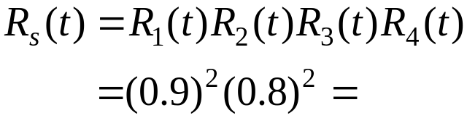
Examples (Series System)
Example 1:
Suppose a system consists of 4 components arranged in series. The first two components have reliabilities of 0.9 at time t = 1 year and the other two components have reliabilities of 0.8 at t = 1 year. What is the overall reliability of the system at one year?
Solution:
The probability of the system operating successfully at the end of the 1st year is:

Slide 7

Series System (cont.)
Limit on System Reliability
The system reliability can not be greater than the smallest component reliability, why?
It is important for all components to have a high reliability, especially when the system has a large number of components.

Slide 8
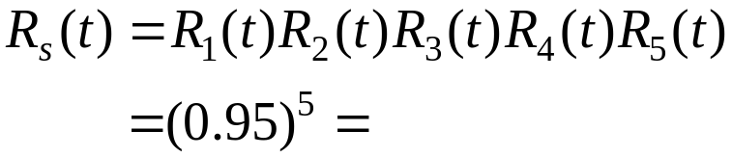
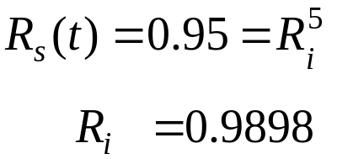
Examples (Series System)
Example 2:
A truck cab assembly line is under development. The line will utilize five welding robots.
a) If each robot has 95 percent reliability, what is the total robot system reliability for the line?
b) To have a robot system reliability of 95 percent, what must each individual robot’s reliability be?
Solution:
(a)
(b)

Slide 9
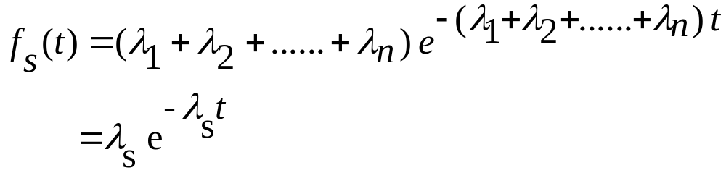
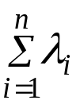
Exponential Distribution
(Series System)
If the times-to-failure of the components behave according to the exponential p.d.f, then the overall p.d.f of times-to-failure is also exponential:
Where: λ_{s} = = The hazard rate of the series system
In addition, for exponentially distributed times to failure of unit i, the unit reliability is:
R_{i} (t) = exp (-λ_{i} t)
The mean time to failure in this case is:
MTTF_{s}= ∫exp (- ∑λ_{i} t) dt = 1/ ∑λ_{i} =1/ λ_{s}

Slide 10
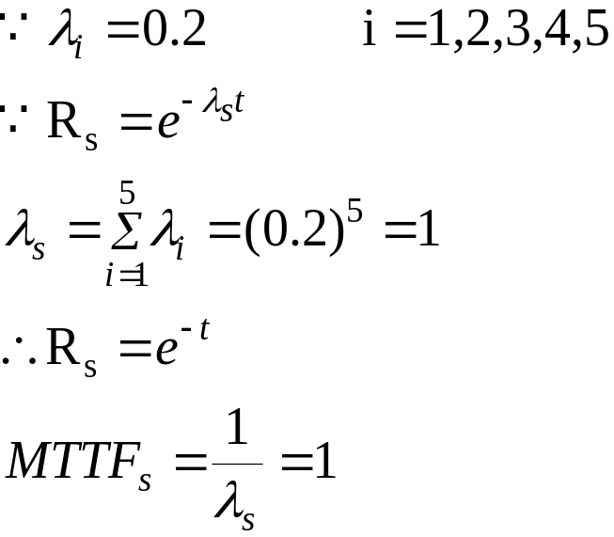
Examples (Series System)
Example 3: Exponential case
Five components in series are each distributed exponentially with a hazard rate of 0.2 failures per hour. What is the reliability and MTTF of the system?
Solution

Slide 11
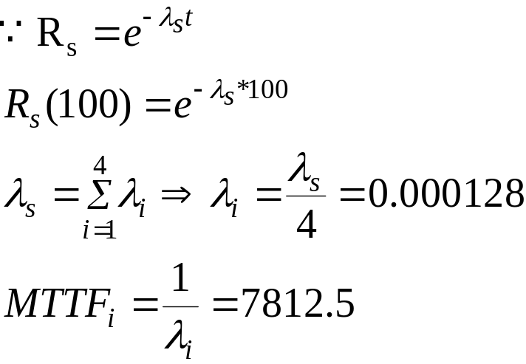
Examples (Series System)
Example 4: Consider a 4-component series system with iid failure distributions having CFR. Suppose Rs(100) = 0.95. What is individual component MTTF?
Solution

Slide 12
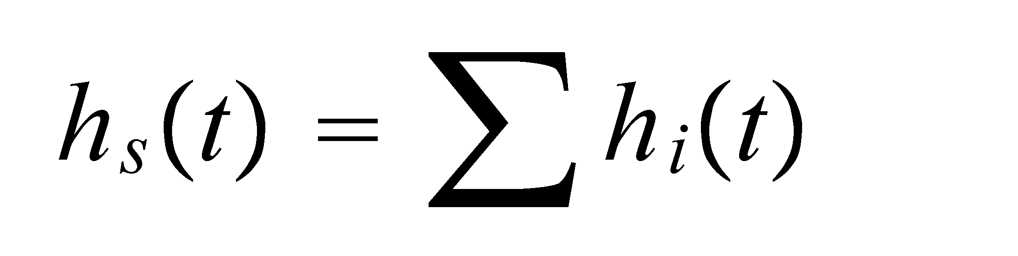
Series System (cont.)
What is system hazard rate hs(t) for series system?

Slide 13
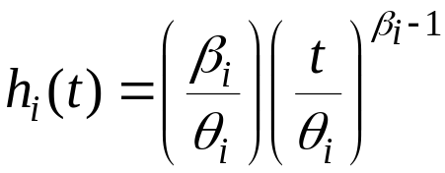
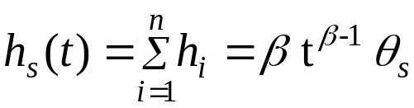
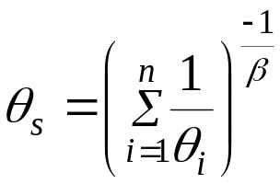

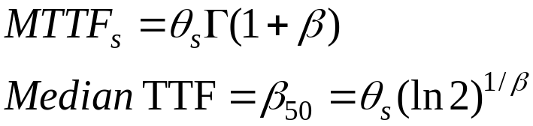
Weibull Distribution
(Series System)
For n components with the same shape parameter β

Slide 14

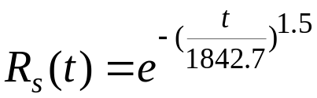
Examples (Series System)
Example 6*: Weibull case
A jet engine consists of 5 modules each of which has a Weibull TTF distribution with shape parameter β= 1.5. The scale parameters (in operating cycles) are: 3600, 7200, 5850, 4780, 9300. Find the MTTF, median TTF, and the reliability of the engine.
Solution

Slide 15
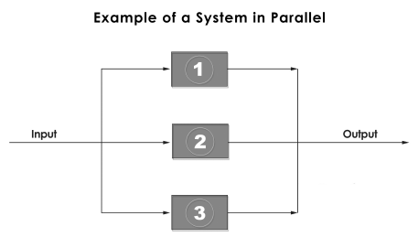
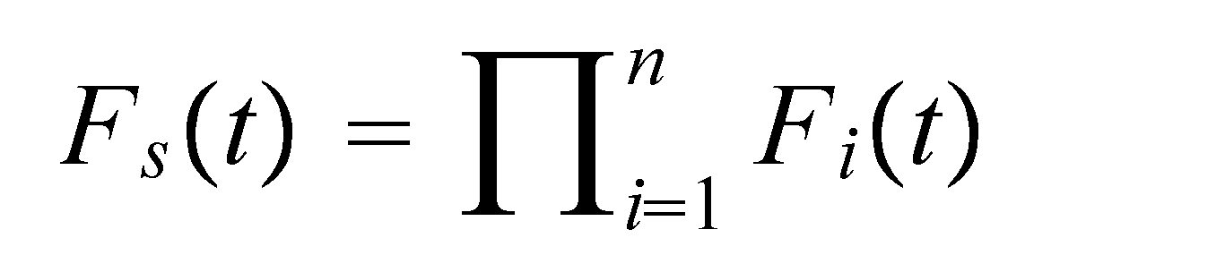
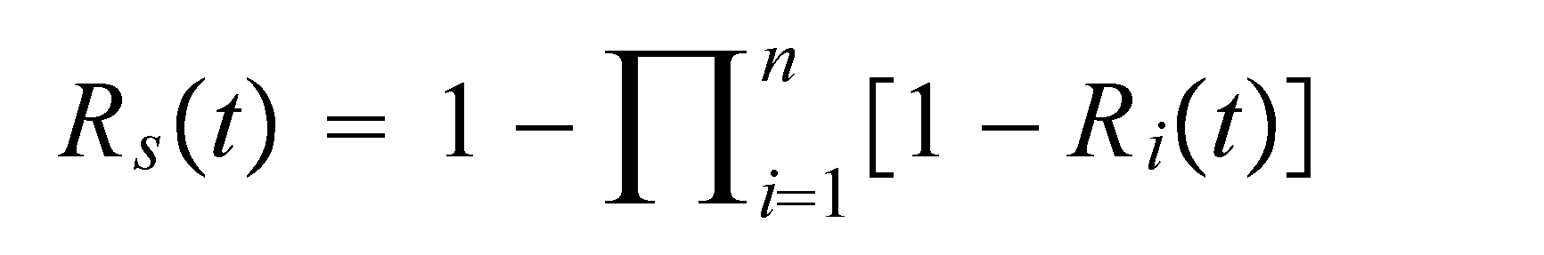
Parallel System
(Redundant System)
In a parallel system, all components must fail for the system to fail. (A parallel system works as long as any one of the components works.)
Reliability Block Diagram
Applications:
Jet engines, Braking systems
Tires in trucks, Projector light bulbs
Basic Equation for System Reliability:
For parallel systems, it is easier to work with failure probability than reliability

Slide 16
Examples (Parallel System)
Example 1: Suppose a system consists of 4 components arranged in parallel. The first two components have reliabilities of 0.9 and time t = 1 year and the other two components have reliabilities of 0.8 at t = 1 year. What is the overall reliability of the system at one year?
Solution

Slide 17

Examples (Parallel System)
Limit on System Reliability
The system reliability can not be less than the largest component reliability, why?
Example 2:
0.80
0.95
0.80
0.95
0.80
0.95
0.80
0.95
0.80
0.95
0.80
0.95
0.80
0.95
0.80
0.95
0.80
0.95

Slide 18
Exponential Distribution
(Parallel System)
If the times-to-failure of the components behave according to the exponential p.d.f, then the overall p.d.f of times-to-failure is not a simple exponential. For example, if the system compose of two component, then the system times-to-failure p.d.f :
ƒ(t) = λ₁ exp(-λ₁t) + λ₂ exp(-λ₂t) – (λ₁+ λ₂) exp (-(λ₁+λ₂)t)

Slide 19
Exponential Distribution
(Parallel System)
For exponentially distribution times to failure of unit i, the parallel system reliability is:
R_{s} = 1- Π (1- exp (-λ_{i} t))
And for identical units (λ_{i} = λ) the reliability of the parallel system simplifies to:
R_{s} = 1 – (1- exp (-λt))
And the mean time to failure for the identical unit parallel system is:
MTTF_{s} = ∫[ 1- (1 – exp (-λt)) ] dt = 1/λ ∑ 1/i
The mean time to failure in this case:
MTTF = ∫ ƒ(t) t dt
= 1/λ₁ + 1/λ₂ – 1/(λ₁+λ₂)

Slide 20
Parallel Systems
Example
A system composes of three components. These components have constant failure rates of 0.0004, 0.0005, 0.0003 failures per hour. The system will stop working, if any one of its components fails. Calculate the following:
1. The reliability of the system at 2500 hour running time?
2. The system hazard rate?
3. Mean time to failure of the system?
Solution

Slide 21
Parallel Systems
Example
Another system composes of four items and each one of these items has constant failure rate of 0.0008 failures per hour. These items when they work the system will work. However, when any one of the system's items fails, the whole system will come to a complete halt. Calculate the following:
1. The reliability of the system at 2000 hour running time?
2. The system hazard rate?
3. Mean time to failure of the system?
Solution

Slide 22
Parallel Systems
Example
A machine has two independent cutting parts. Any one of these cutting parts is sufficient to operate the machine. The hazard rates for the two parts of this machine are constant and they are 0.001 and 0.0015 failures per hour. Calculate:
1.The survival probability of the machine at 300 hour of running time?
2.The mean time to failure for this machine?
Solution

Slide 23
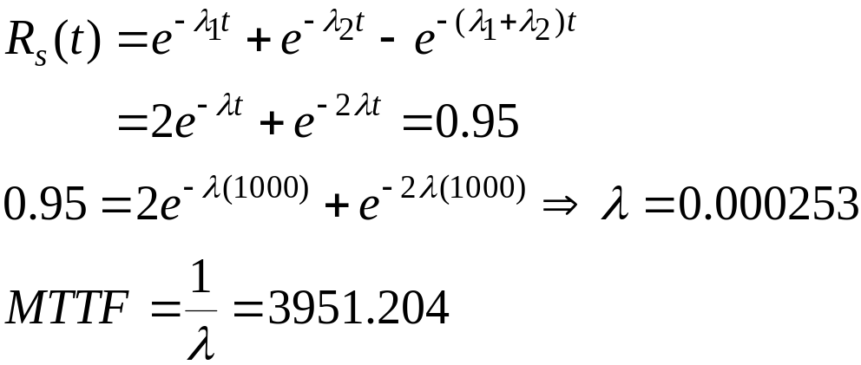
Examples (Parallel System)
Example 4: System has two identical components in parallel with CFR of λ. We want Rs(1000) = 0.95. What should component MTTF be?
Solution

Slide 24
Parallel Systems
The advantages of connecting equipment in parallel are:
To improve reliability of the system by making some of the equipment redundant to the other.
Extensive preventive maintenance can be pursued with no loss in plant availability since the separate parallel units can be isolated.
In the event of failure corrective maintenance can be arranged under less pressure from production or from competing maintenance tasks.
In the case of very high reliability units, there are only very marginal increments in reliability to be gained by installing redundant capacity unless the safety factors become evident.

Slide 25
Combined Series-Parallel Systems
Series and parallel structures are the basis for building more complicated structures which use redundancy to increase system reliability.
Example
0.90
0.70
0.80
0.60
0.90
0.80
0.70
0.99
0.60
0.80

Slide 26
Series and Parallel System Reliability
Combination of serial and parallel structures:
C
R_{A}
R_{B}
R_{C}
R_{D}
A
B
D
C
R_{C}
Convert to equivalent series system
R_{A}
R_{B}
R_{D}
A
B
C’
D
R_{C’} = 1 – (1-R_{C})(1-R_{C})

Slide 27
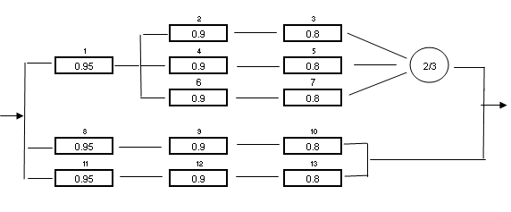
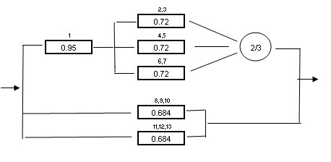
Series and Parallel System Reliability
Example
Solution

Slide 28
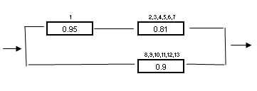
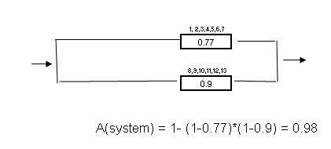
Series and Parallel System Reliability
Solution

Slide 29
Series and Parallel System Reliability
Example
A system is made up of three components. Component #1 has a normal life distribution with a mean of 1000 hours and a standard deviation of 250 hours. Component #2 has a Weibull distribution with θ = 1100 hours and β = 0.85, and component # 3 has an Exponential distribution with a mean of 1400 hours. The system fails when the first component fails. What is the reliability of the system at 900 hours?
Solution

Slide 30
Combined Series-Parallel Systems
Redundancy in systems can be accomplished either at system level (high level) or at component level (low level) or some combination:
High-level (system-level) Redundancy
Low-level (component-level) Redundancy
k-out-of-n Redundancy

Slide 31
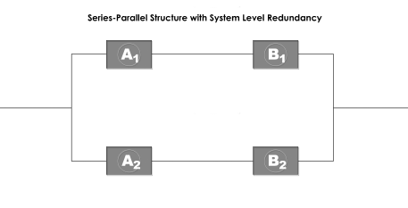
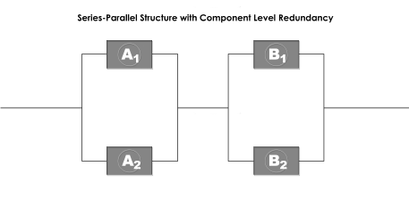
High-level versus Low-level Redundancy
For a simple system with two components, A and B.
A combined series-parallel structure with system-level (or high-level) redundancy
A combined series-parallel structure with component-level (low-level) redundancy
Computing reliabilities: Which has higher reliability? High or low level redundancy?

Slide 32
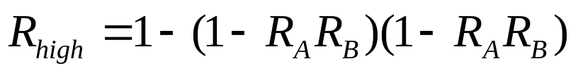
High-level Redundancy
Examples:
  Dual central processors for critical switching communication systems
  Automobile brake systems
  Transatlantic undersea transmission cables
Reliability of the system:

Slide 33
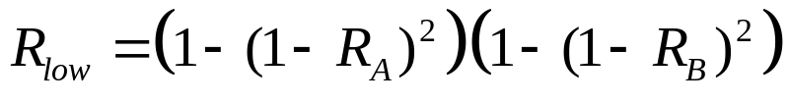
Low-level Redundancy
Examples:
  Dual repeaters in undersea cables
  Human body (kidneys and lungs) …
Reliability of the system:

Slide 34
Examples (High or Low Level)
Which has higher reliability? High or low level? Why?
Example: A radio consists of 3 major components: power supply, receiver, and amplifier, with R of 0.8, 0.9, and 0.95 respectively for some design life L. Compute system reliability for both high-level and low-level redundancy with two parallel components. Which would be higher?
0.80
0.90
0.95
0.80
0.90
0.95
0.80
0.90
0.95
0.80
0.90
0.95
If redundancy is to be used to improve reliability, it should be applied at the lowest possible level in the design.

Slide 35
k-out-of-n Redundancy
The system works if k or more of the n components work
Series and parallel systems are special cases of k-out-of-n systems:
  parallel systems: 1-out-of-n system (k=1)
  series systems: n-out-of-n system (k=n)
Examples:
  A bicycle wheel that needs only k out of its n spokes to function
  An automobile engine that needs only k of its n cylinders to run
  Satellite battery systems which continue to operate as long as there are 6 out of 10 batteries working

Slide 36

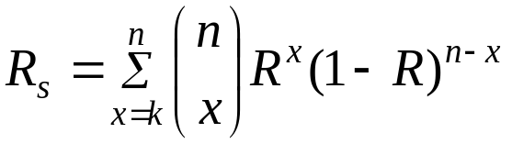
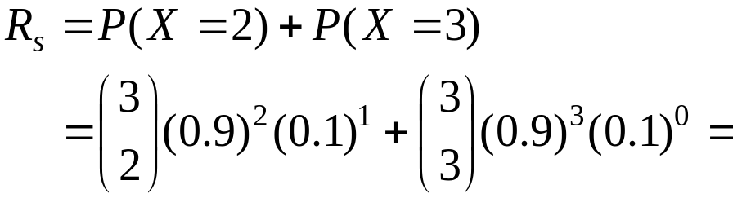
k-out-of-n Redundancy
For independent identical distributed components ( ), the reliability of k-out-of-n system (the probability of k or more successes from among the n components) is:
Example 1: For a 2-out-of-3 system (a special case of k-out-of-n system), each component has reliability of 0.9. What is the system reliability?

Slide 37
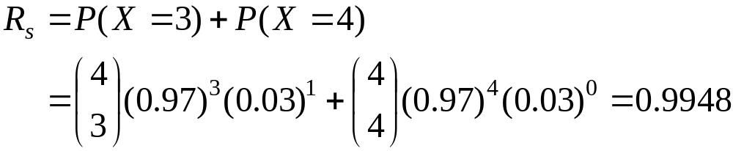
Examples (k-out-of-n)
Example 2:
A space shuttle requires 3-out-of-4 of its main engines to achieve orbit. Each engine has a reliability of 0.97. What is the probability of achieving orbit?
Solution
n = 4 k = 3 R = 0.97

Slide 38
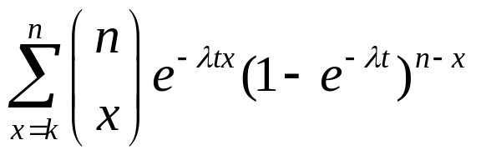


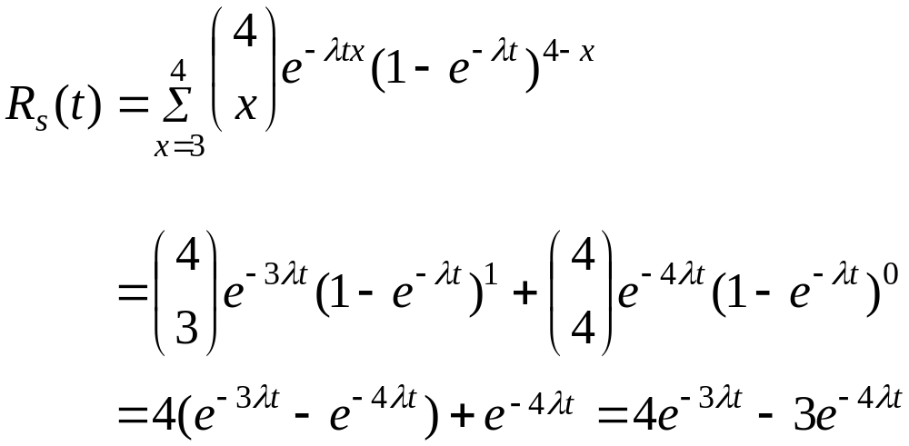

k-out-of-n Redundancy
Exponential failures
Example 3: Suppose each engine has CFR= 0.0038074. Again assuming 3-out-of-4 structure, what is system MTTF?
Solution
n = 4 k = 3 λ = 0.0038074

Slide 39
Reliability Design
The reliability level of a system is determined during the design process.
The design process dictates the system configuration, which influences the reliability level.
The designer should be familiar with the basic reliability analysis concepts that can be used to evaluate the design.

Slide 40
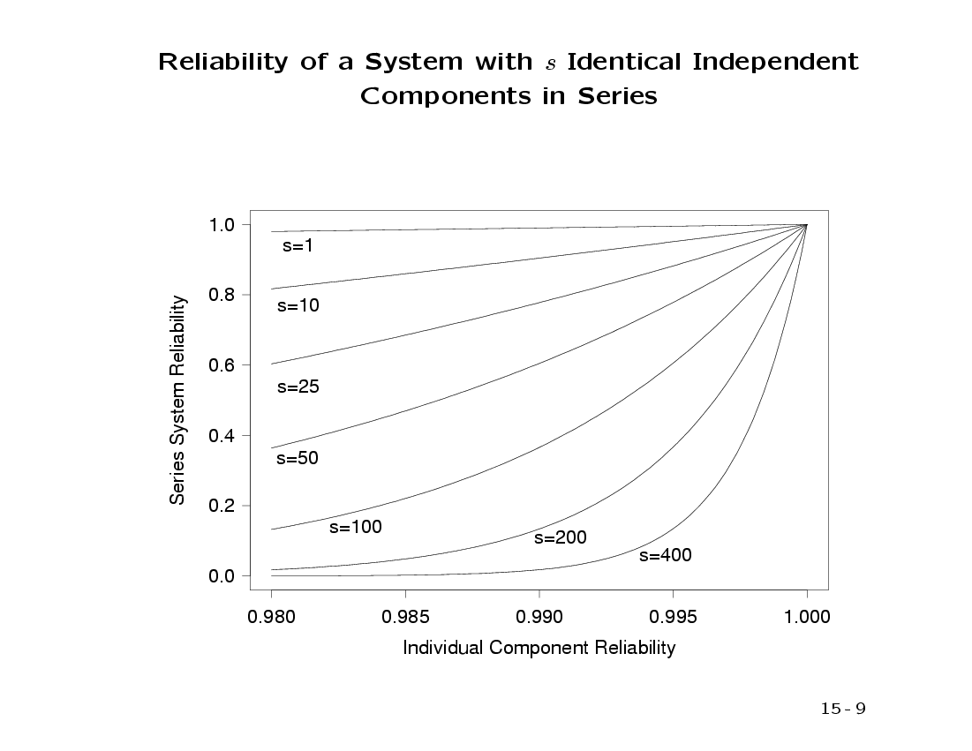
Reliability Consideration in Series-System Design
Two determinants of the system reliability of a series system:
  The component reliability level
  The number of components
The reliability of a series system can be improved by
  Increasing the component reliability
  Decreasing the number of series components

Slide 41
Reliability Consideration in Parallel-System Design
Parallel-system is a means for increasing reliability.
Advantages:
  Quickest solution if time is of major concern.
  An easy and natural solution in some design situations
  The only solution if the reliability requirement is beyond the state-of-the-art.
Disadvantages:
  May not be feasible or possible from a design standpoint
  Switching mechanism may be needed and may defeat reliability gains
  In highly reliable systems the gains will be small
  May exceed weight and size limitations
  Cost may be prohibitive
  Power consumption may be increased
  Repair frequency may increase

Slide 42
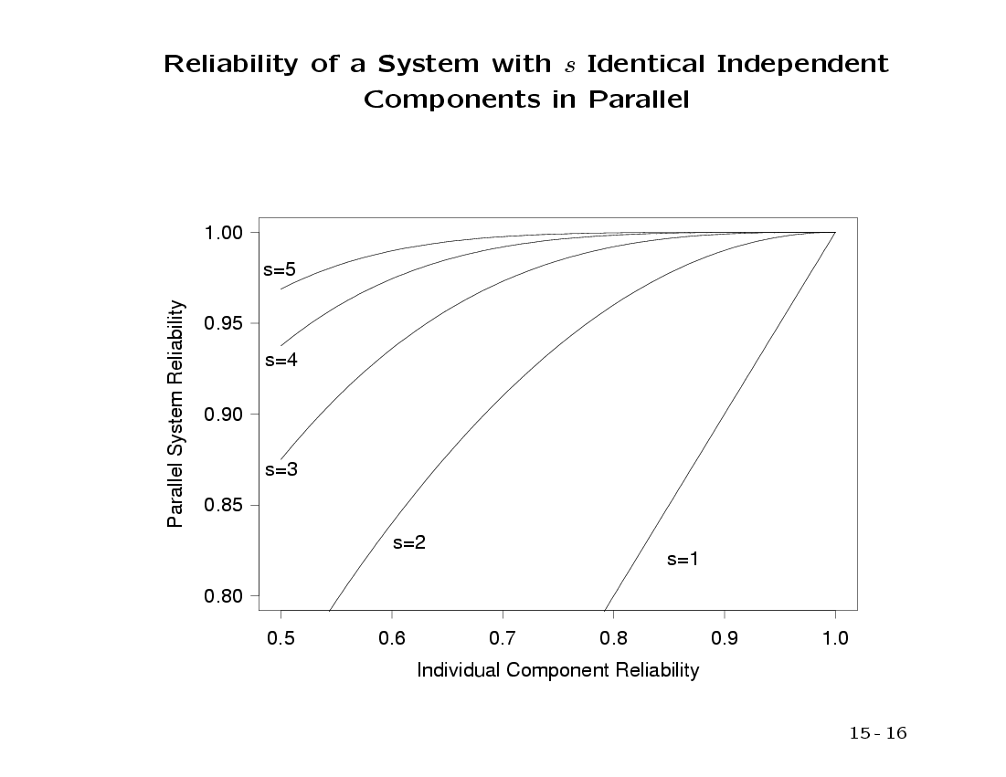
Reliability Consideration in Parallel-System Design

